Slide 1
Handover Improvement Trajectory

Slide 2
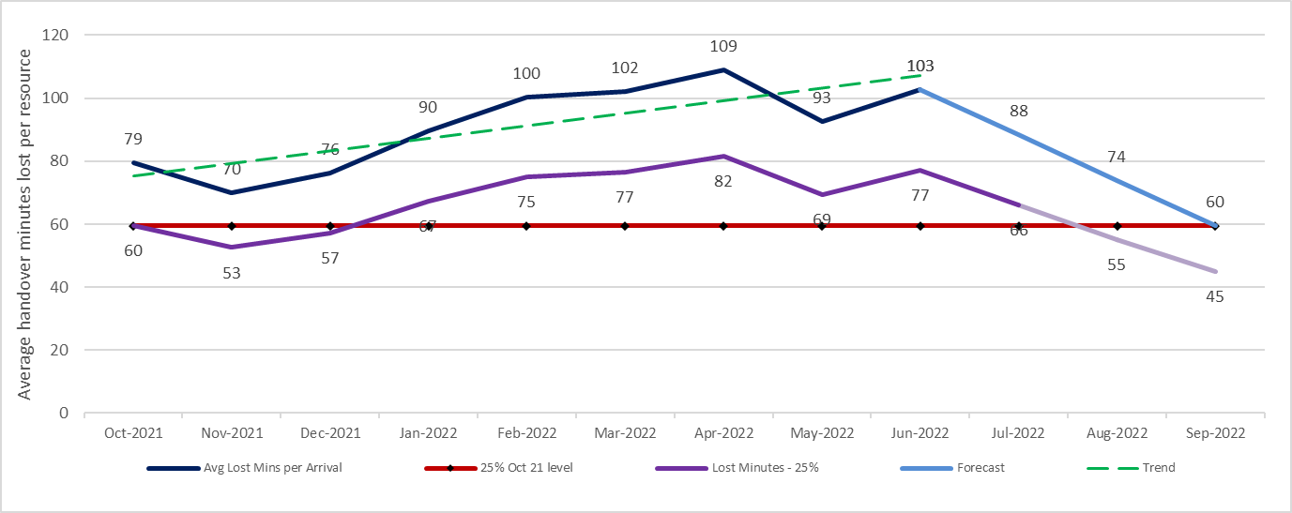
Handover Improvement Trajectory
NHS Wales
The graph left shows in red a 25% reduction based on a baseline of 79 minute lost per arrival nationally in October 2021.
The dark blue line depicts the actual reported lost minutes per arrival reported by the Welsh Ambulance Services NHS Trust from October 2021 to June 2021.
The light blue line for July to September 2022 is a forecasted position to bring it to or below the original October 2021 baseline.
The middle purple line depicts the actual reported lost hours with a 25% reduction applied. The light purple line is a forecasted reduction for July to September 2022 to bring it to or below the original October 2021 baseline.
The data contained in the graph is based on arrivals at hospital

Slide 3
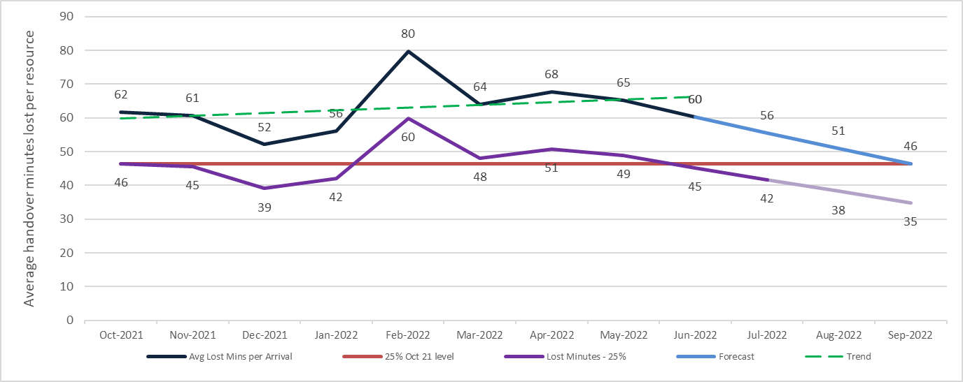
Handover Improvement Trajectory
Aneurin Bevan University Health Board
The graph left shows in red a 25% reduction based on a baseline average of 62 minute lost per arrival in October 2021.
The dark blue line depicts the actual reported lost minutes per arrival reported by the Welsh Ambulance Services NHS Trust from October 2021 to June 2021.
The light blue line for July to September 2022 is a forecasted position to bring it to or below the original October 2021 baseline.
The middle purple line depicts the actual reported lost hours with a 25% reduction applied. The light purple line is a forecasted reduction for July to September 2022 to bring it to or below the original October 2021 baseline.
The data contained in the graph is based on single vehicle / single patient arrival at hospital

Slide 4
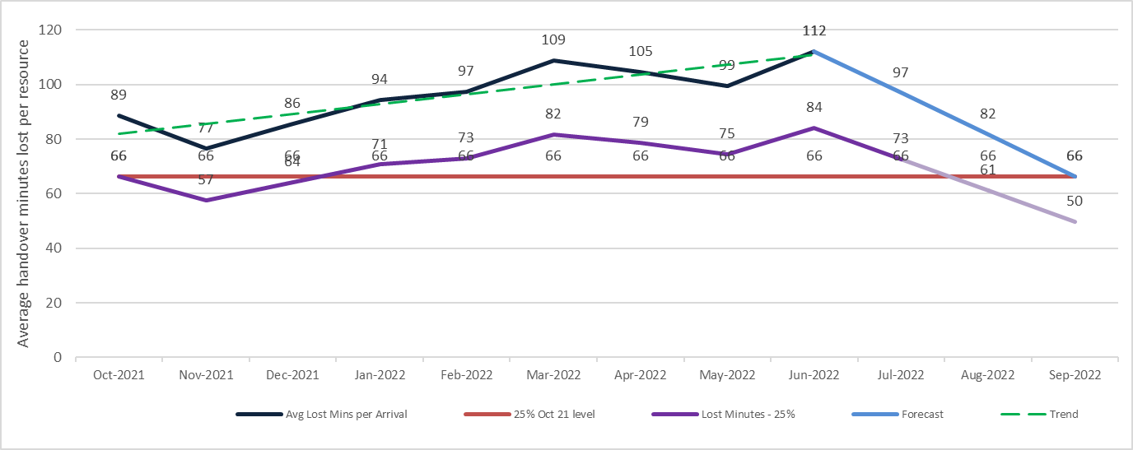
Handover Improvement Trajectory
Betsi Cadwaladr University Health Board
The graph left shows in red a 25% reduction based on a baseline of 89 minute lost per arrival in October 2021.
The dark blue line depicts the actual reported lost minutes per arrival reported by the Welsh Ambulance Services NHS Trust from October 2021 to June 2021.
The light blue line for July to September 2022 is a forecasted position to bring it to or below the original October 2021 baseline.
The middle purple line depicts the actual reported lost hours with a 25% reduction applied. The light purple line is a forecasted reduction for July to September 2022 to bring it to or below the original October 2021 baseline.
The data contained in the graph is based on single vehicle / single patient arrival at hospital

Slide 5
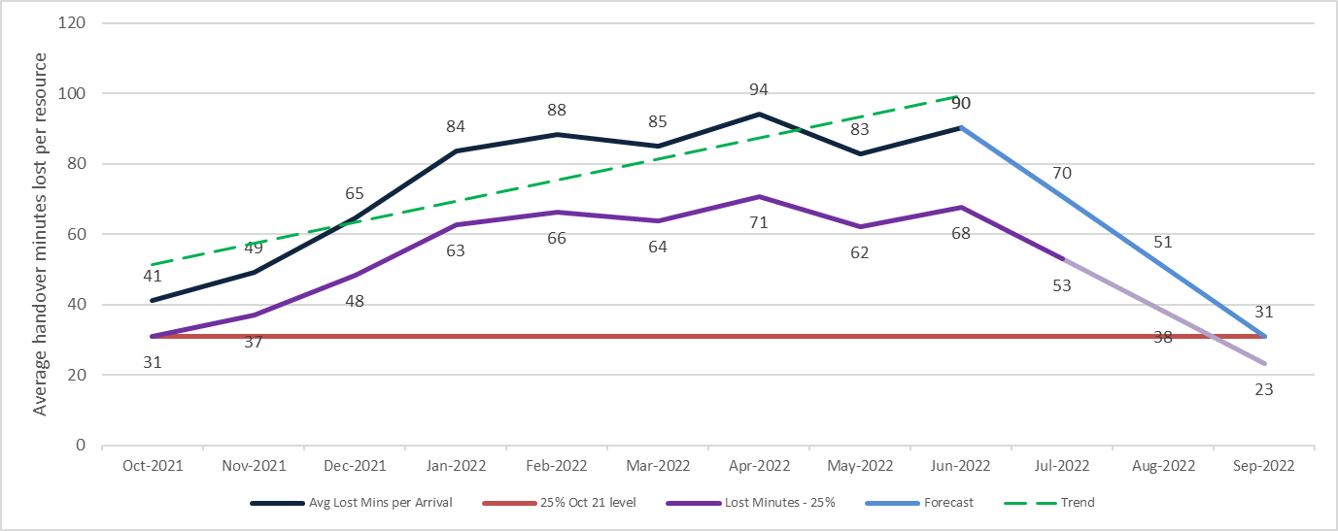
Handover Improvement Trajectory
Cardiff and Vale University Health Board
The graph left shows in red a 25% reduction based on a baseline of 41 minute lost per arrival in October 2021.
The dark blue line depicts the actual reported lost minutes per arrival reported by the Welsh Ambulance Services NHS Trust from October 2021 to June 2021.
The light blue line for July to September 2022 is a forecasted position to bring it to or below the original October 2021 baseline.
The middle purple line depicts the actual reported lost hours with a 25% reduction applied. The light purple line is a forecasted reduction for July to September 2022 to bring it to or below the original October 2021 baseline.
The data contained in the graph is based on single vehicle / single patient arrival at hospital

Slide 6
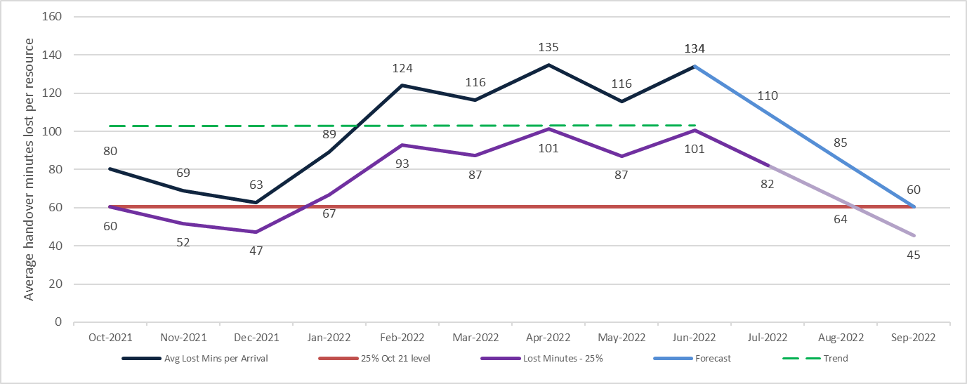
Handover Improvement Trajectory
Cwm Taf Morgannwg University Health Board
The graph left shows in red a 25% reduction based on a baseline of 80 minute lost per arrival in October 2021.
The dark blue line depicts the actual reported lost minutes per arrival reported by the Welsh Ambulance Services NHS Trust from October 2021 to June 2021.
The light blue line for July to September 2022 is a forecasted position to bring it to or below the original October 2021 baseline.
The middle purple line depicts the actual reported lost hours with a 25% reduction applied. The light purple line is a forecasted reduction for July to September 2022 to bring it to or below the original October 2021 baseline.
The data contained in the graph is based on single vehicle / single patient arrival at hospital

Slide 7
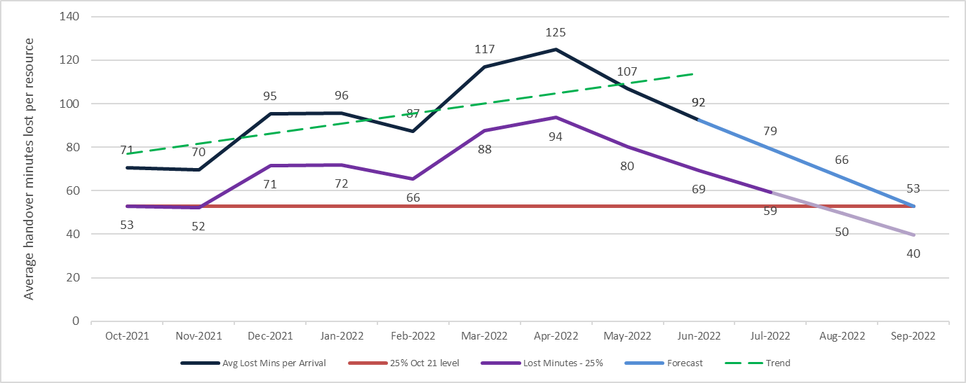
Handover Improvement Trajectory
Hywel Dda University Health Board
The graph left shows in red a 25% reduction based on a baseline of 71 minute lost per arrival in October 2021.
The dark blue line depicts the actual reported lost minutes per arrival reported by the Welsh Ambulance Services NHS Trust from October 2021 to June 2021.
The light blue line for July to September 2022 is a forecasted position to bring it to or below the original October 2021 baseline.
The middle purple line depicts the actual reported lost hours with a 25% reduction applied. The light purple line is a forecasted reduction for July to September 2022 to bring it to or below the original October 2021 baseline.
The data contained in the graph is based on single vehicle / single patient arrival at hospital

Slide 8
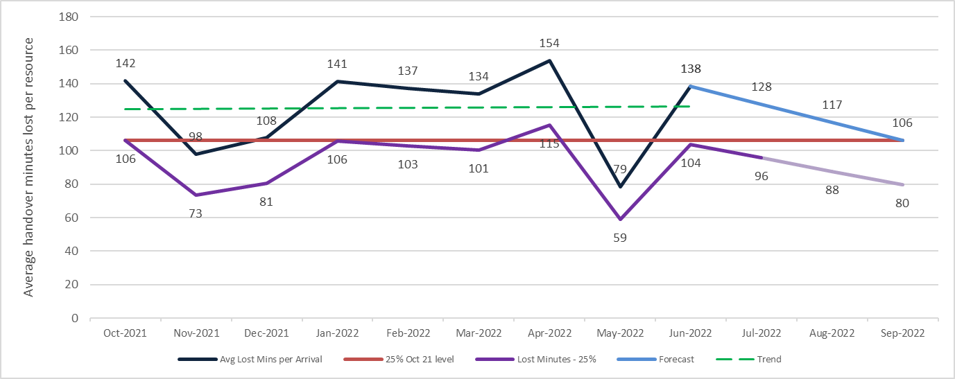
Handover Improvement Trajectory
Swansea Bay University Health Board
The graph left shows in red a 25% reduction based on a baseline of 142 minute lost per arrival in October 2021.
The dark blue line depicts the actual reported lost minutes per arrival reported by the Welsh Ambulance Services NHS Trust from October 2021 to June 2021.
The light blue line for July to September 2022 is a forecasted position to bring it to or below the original October 2021 baseline.
The middle purple line depicts the actual reported lost hours with a 25% reduction applied. The light purple line is a forecasted reduction for July to September 2022 to bring it to or below the original October 2021 baseline.
The data contained in the graph is based on single vehicle / single patient arrival at hospital

